Slide 1
Analysis and characterization of different three-phase PLL schemes for phase tracking under grid imperfections
Mentor: Prof. Dr. C. Nagamani
Pradhyumna R 107108077
Sambhav R Jain 107108103

Slide 2
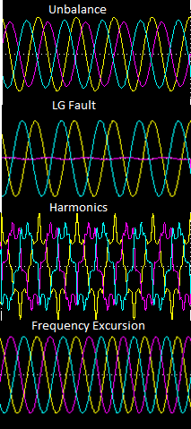
Need for phase tracking
Control of distributed generation systems
Synchronization between grid-interfaced converters and utility networks
Ride-through capability
Control of FACTS devices
(e.g. STATCOM, SSSC, TCR)
Imperfections of the grid
Balanced voltage sags, swells
Unbalance
LG fault, load unbalance, load shedding
Harmonics
Frequency excursion

Slide 3
Expectation of an ideal three phase PLL
Ability to track accurately, the phase angle and frequency of utility voltage even under unbalanced and distorted conditions
Ability to accurately measure the positive sequence fundamental component of the utility voltage
Analysis and characterization of the existing three-phase PLL techniques under such imperfections is to be studied

Slide 4
Existing PLL methods for grid imperfections
DDSRF – Decoupled Double Synchronous Reference Frame PLL
MCCF – Multiple Complex Coefficient Filter based 3-phase PLL
DSOGI – Double Second Order Generalized Integrator based 3-phase PLL
VSPF – Variable Sampling Period Filter based 3-phase PLL (discrete PLL)
The methods listed above are some of the existing PLL methods in literature. They have been chosen for our analysis as most of the improvisations are based on them.

Slide 5
Work-plan for Jan to April, 2012
January
Understanding and short-listing of the existing 3-phase PLL schemes dealing with grid imperfections
February
Simulations and comparisons of the same
March
Design optimization and improvisation of the better schemes (based on simulation results)
April
Implementation and testing of the optimized method

Slide 6
Thank you

Slide 7
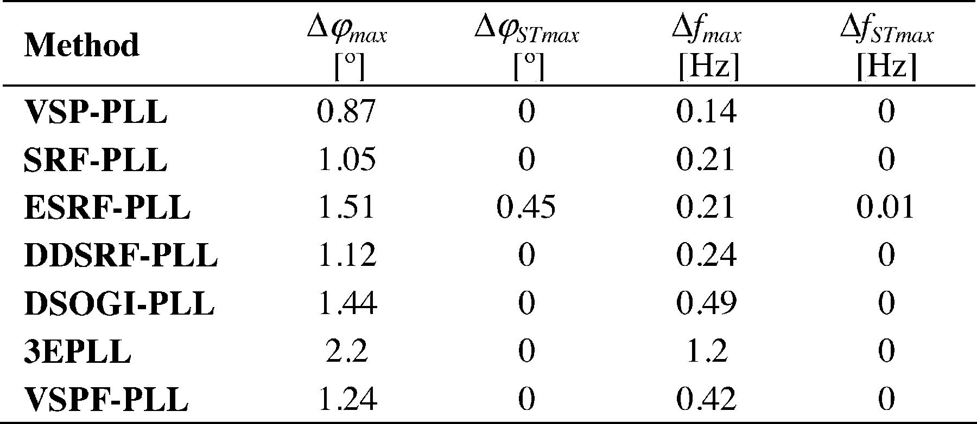
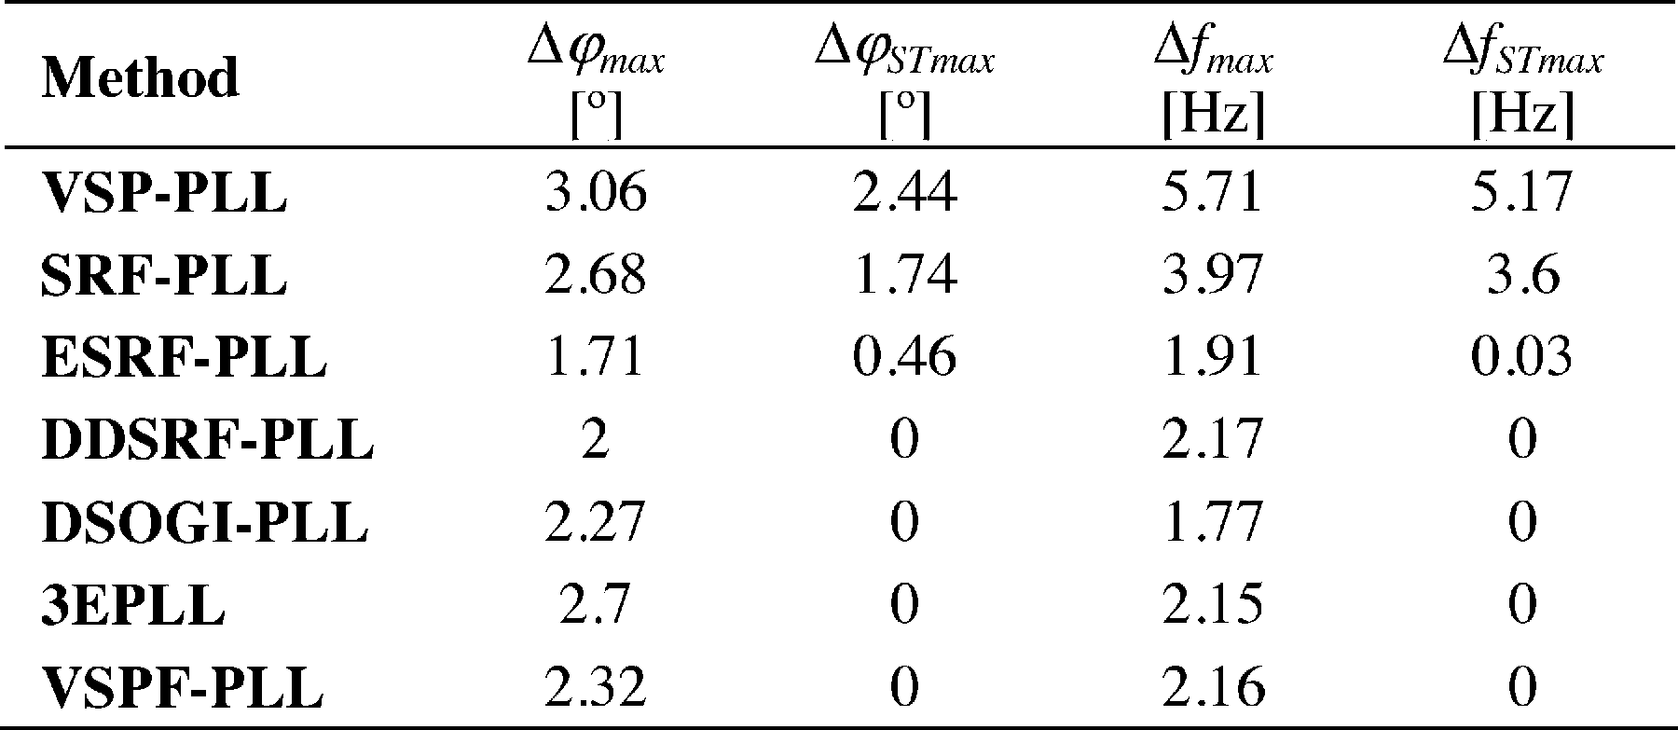
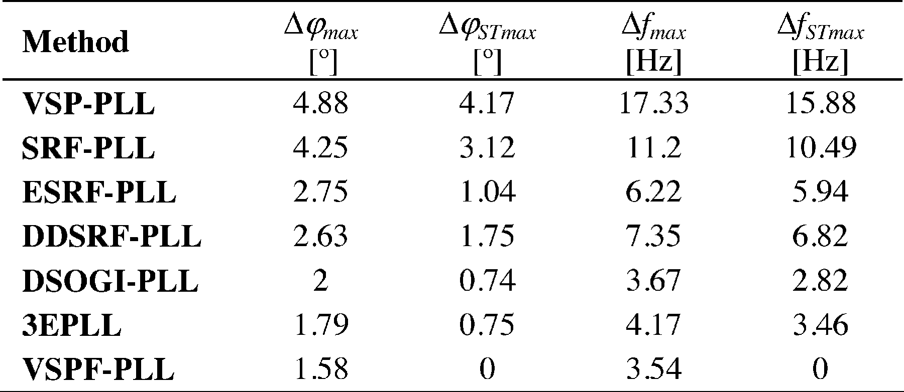
Comparisons
Step Frequency
Unbalanced Grid
Fifth Harmonic
Ref: Variable Sampling Period Filter PLL for Distorted Three-Phase Systems by Ignacio Carugati, Sebastian Maestri, Patricio G. Donato, Daniel Carrica

